Slide 1

Logic circuits
Cibotariu andrei

Slide 2

chapters
Theory
Problem statement
Solution
1.
2.
3.

Slide 3
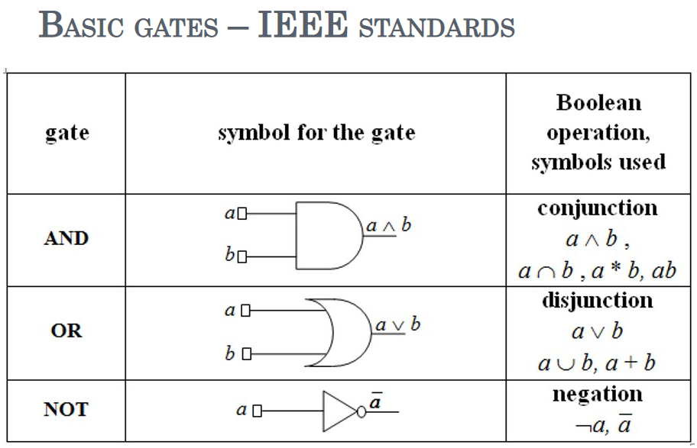
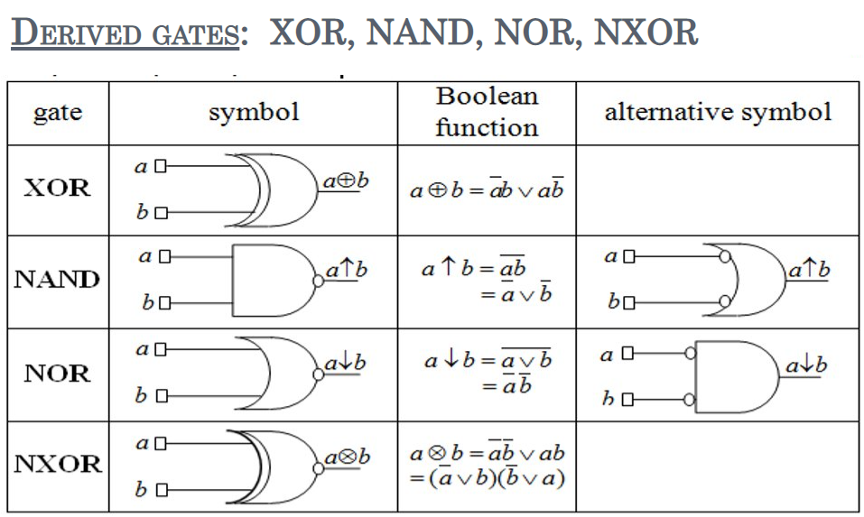
theory

Slide 4

Problem statement

Slide 5
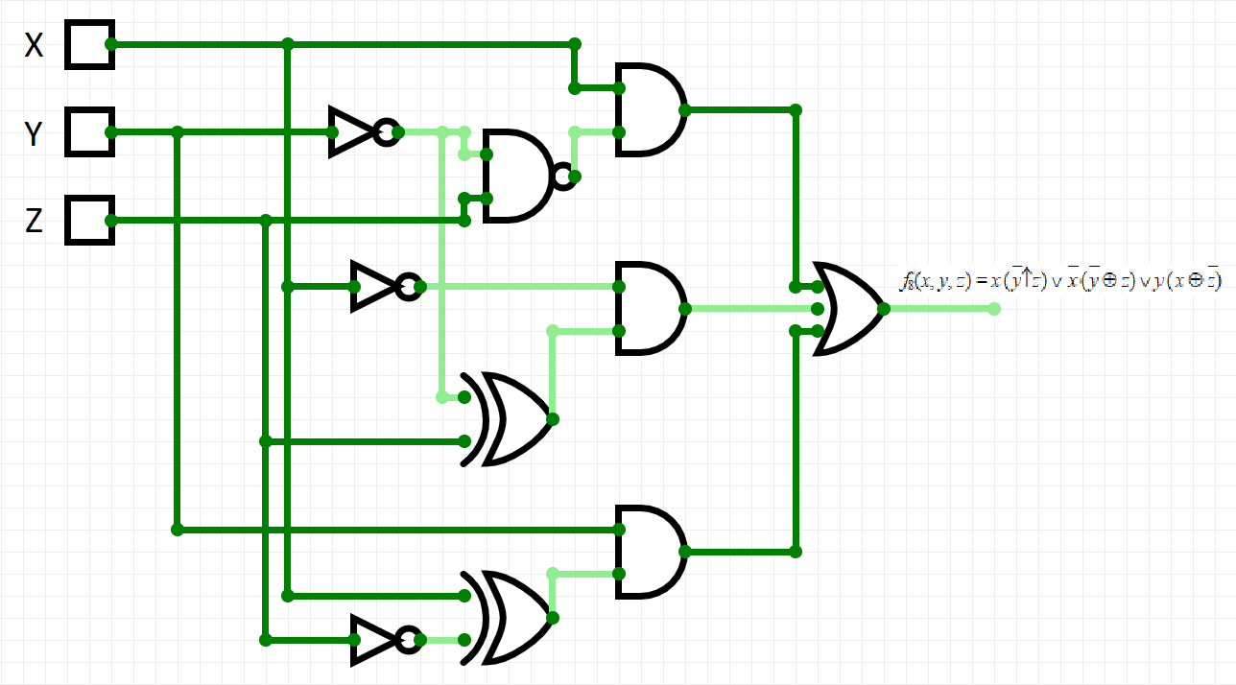
solution

Slide 6
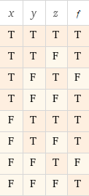
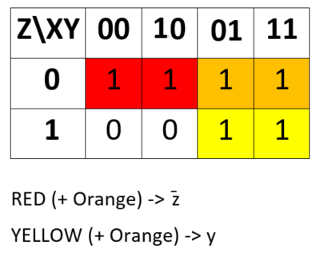
solution
After we simplify the given boolean function (using Karnaugh), we obtain:
f₈(x, y, z) = y ∨ ¯z,
which is in both CNF and DNF.
The logic circuit associated to this function is:

Slide 7
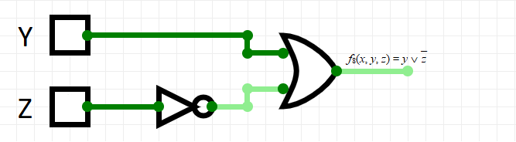
solution

Slide 8

Thank You

